Slide 1
PORTFOLIO WEBSITE.

Slide 2
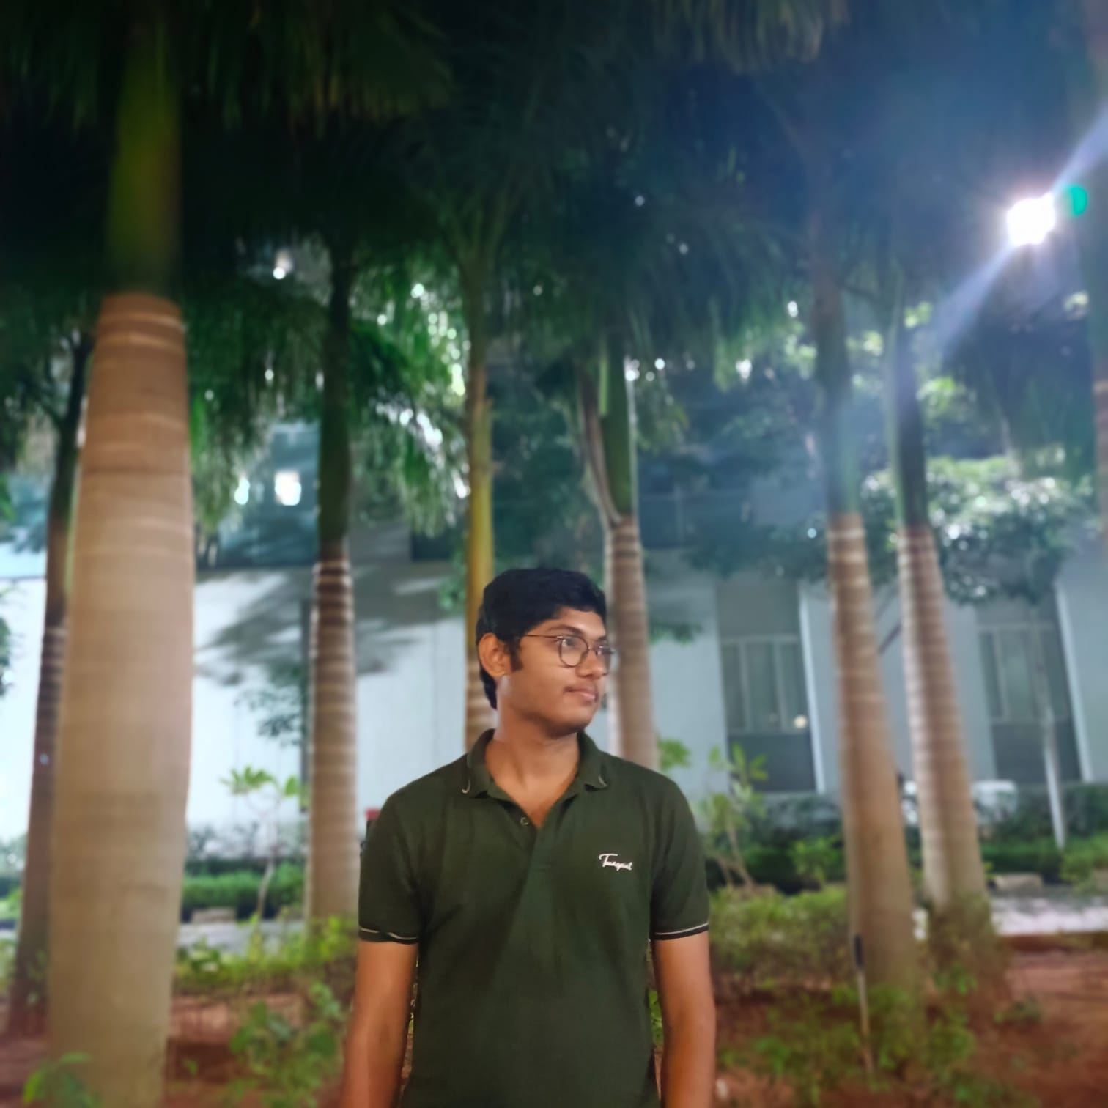
STUDENT DETAILS
Name : Bulusu V S Sri Sai Praneeth
Email Id: vssrisaipraneeth_bulusu@srmap.edu.in
College Name : SRM University
College State : Andhra Pradesh
Internship Domain : Front-end Development
Internship Duration : 03/06/2024 to 26/07/2024

Slide 3
PROBLEM STATEMENT
A lot of people struggle to make their resumes stand out from the competition, which can be detrimental to their academic and professional prospects. We certainly need to provide a platform that helps them manage their portfolios in an efficient and user-friendly manner.
We need to develop a platform for such users to display their skills and make their portfolios an accurate representation of their abilities and accomplishments.

Slide 4
Agenda
Project overview
Who are all end users for this project?
My solution and its value proposition
How did I customize the project and make it on my own
Modelling
Technologies Used
Results
Links

Slide 5
Project overview
To provide a smooth user experience, the portfolio is designed utilizing languages like HTML, CSS, and JavaScript. It highlights distinct sections such as projects, abilities, professional experience, and contact details making it easy and efficient to use.
As each section has been thoughtfully divided, users can quickly navigate and explore it. The website is responsive and compatible across a range of screen sizes and devices making it a best fit for building a professional portfolio.

Slide 6
WHO ARE ALL END USERS OF THE PROJECT?
The portfolio website functions as a digital depiction of the user's career path, providing an overview of their work and providing insights into their abilities, projects, and successes.
Potential employers, recruiters, clients, and collaborators who are interested in reviewing the creator's portfolio are end users of this project.
The website seeks to educate and captivate users, enticing them to go further and help the developer for possible joint ventures or partnerships.

Slide 7
My solution and its valued proposition
The portfolio website provides a tailored and polished platform for displaying skills, projects, and accomplishments. Its unique selling point is its capacity to deliver a unified and captivating showcase of the creator's abilities, elevating their professional reputation and trustworthiness.
By personalizing the website's layout and information to mirror personal style and successes, the creator can set themselves apart from peers in their industry and make a memorable impact on viewers.

Slide 8
How did I customize the project and make it on my own
The creator's personal brand and professional goals were the driving force behind the extensive customization of the portfolio site. This involved refining layout, design elements, and content structure to align with the creator's vision.
JavaScript was utilized to implement interactive features such as project galleries, dynamic content loading, and smooth navigation transitions, enhancing user engagement and visual appeal. HTML was used for organizing content like project details and skills, ensuring clarity and accessibility, while CSS played a crucial role in styling, customizing fonts, colors, and layout.

Slide 9
The portfolio site is divided into specific sections—Home, About me, Projects, and Contact me—each designed to improve the visitor's comprehension and engagement with the creator's professional profile:
Home: The Home section acts as the initial page, providing a brief introduction or welcome message. It establishes the site's atmosphere and offers initial navigation to other sections.
About me: The About section presents comprehensive details about the creator, such as their background, experience, and professional interests. It may contain a biography, career goals, educational history, and notable accomplishments.
->Skills: The Skills section showcases the creator's abilities. It typically displays a list or visual representation of skills organized by proficiency levels or relevant skill sets. This section enables visitors to quickly evaluate the creator's strengths.
Projects: The Projects section exhibits the creator's previous work, projects, or case studies. It includes detailed descriptions, images, and potentially links to live demonstrations or GitHub repositories. This section illustrates the practical application of the creator's skills and allows visitors to delve into their work.
Contact me: The contact me section includes the social media links of the creators and also includes the display of the phone number, email id, and the address of the creator. And in the bottom of all those, creator will provide the social media links in which he/she are present for easy connecting.

Slide 10
Modelling
The website's structure was precisely designed with HTML for semantic content association and CSS for styling and arrangement.
Wireframes and prototypes were developed during the modeling phase to continuously ameliorate the point's layout and stoner interface.
Availability was a crucial factor in the design process to guarantee that all druggies, no matter their device or browsing choices, could fluently navigate and engage with the website.

Slide 11
The website is structured with sections like Homepage, About Me, Projects, Skills, Work Experience, and Contact, ensuring seamless adaptation to various screen sizes.
Integrated interactive features like hover effects on buttons, dynamic content loading for smooth navigation, and the possibility of a carousel or image gallery for showcasing projects.
Incorporated visually appealing elements such as high-resolution images, icons, and animations to improve viewer engagement.
Implemented responsive design principles using fluid grid layouts and flexible CSS units to guarantee optimal display on desktops, tablets, and mobile devices.
Established an intuitive navigation system with a dynamic navbar, smooth scrolling, and a fixed position for effortless browsing.

Slide 12
Technologies used
The portfolio site project utilized a blend of fundamental web technologies and robust JavaScript libraries to develop an interactive and adaptable user interface. Key technologies involved were:
- HTML: Utilized to organize the content and establish the structure of the web pages.
- CSS: Implemented for designing the website, guaranteeing a visually pleasing and consistent layout throughout all pages.
JavaScript: Employed for incorporating interactivity and improving the site's functionality.
These combination of technologies gives a result of user-friendly portfolio website, effectively showcasing the creator’s work.

Slide 13
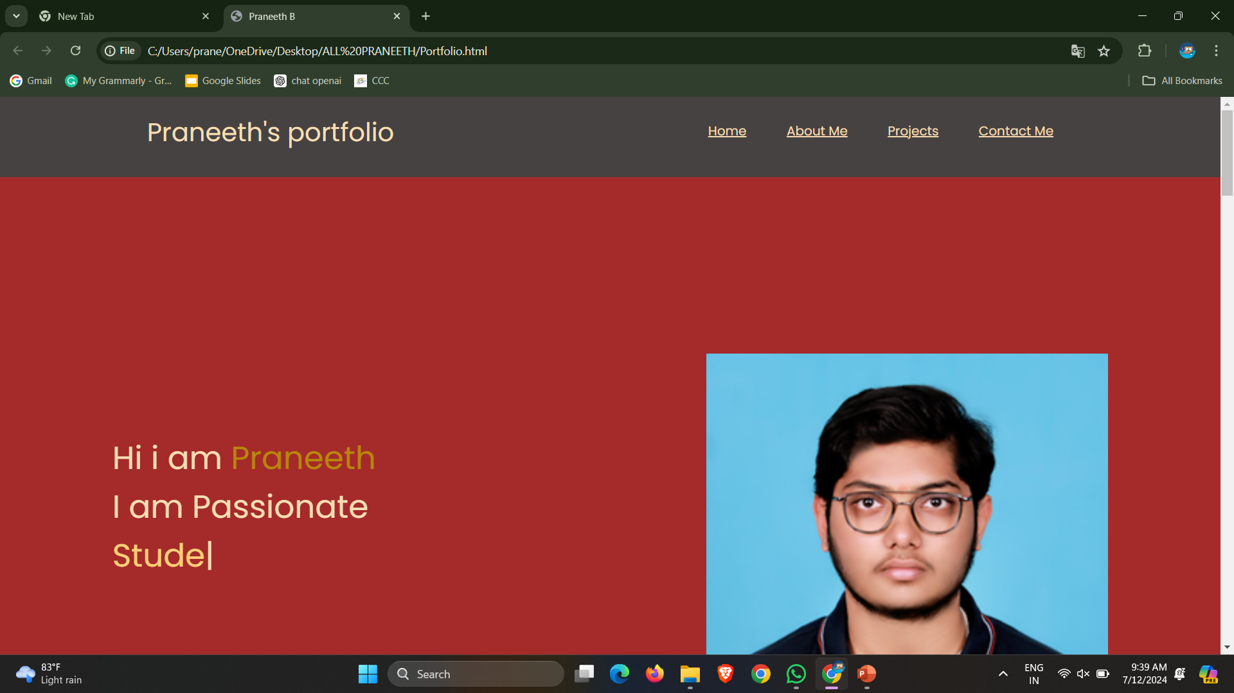
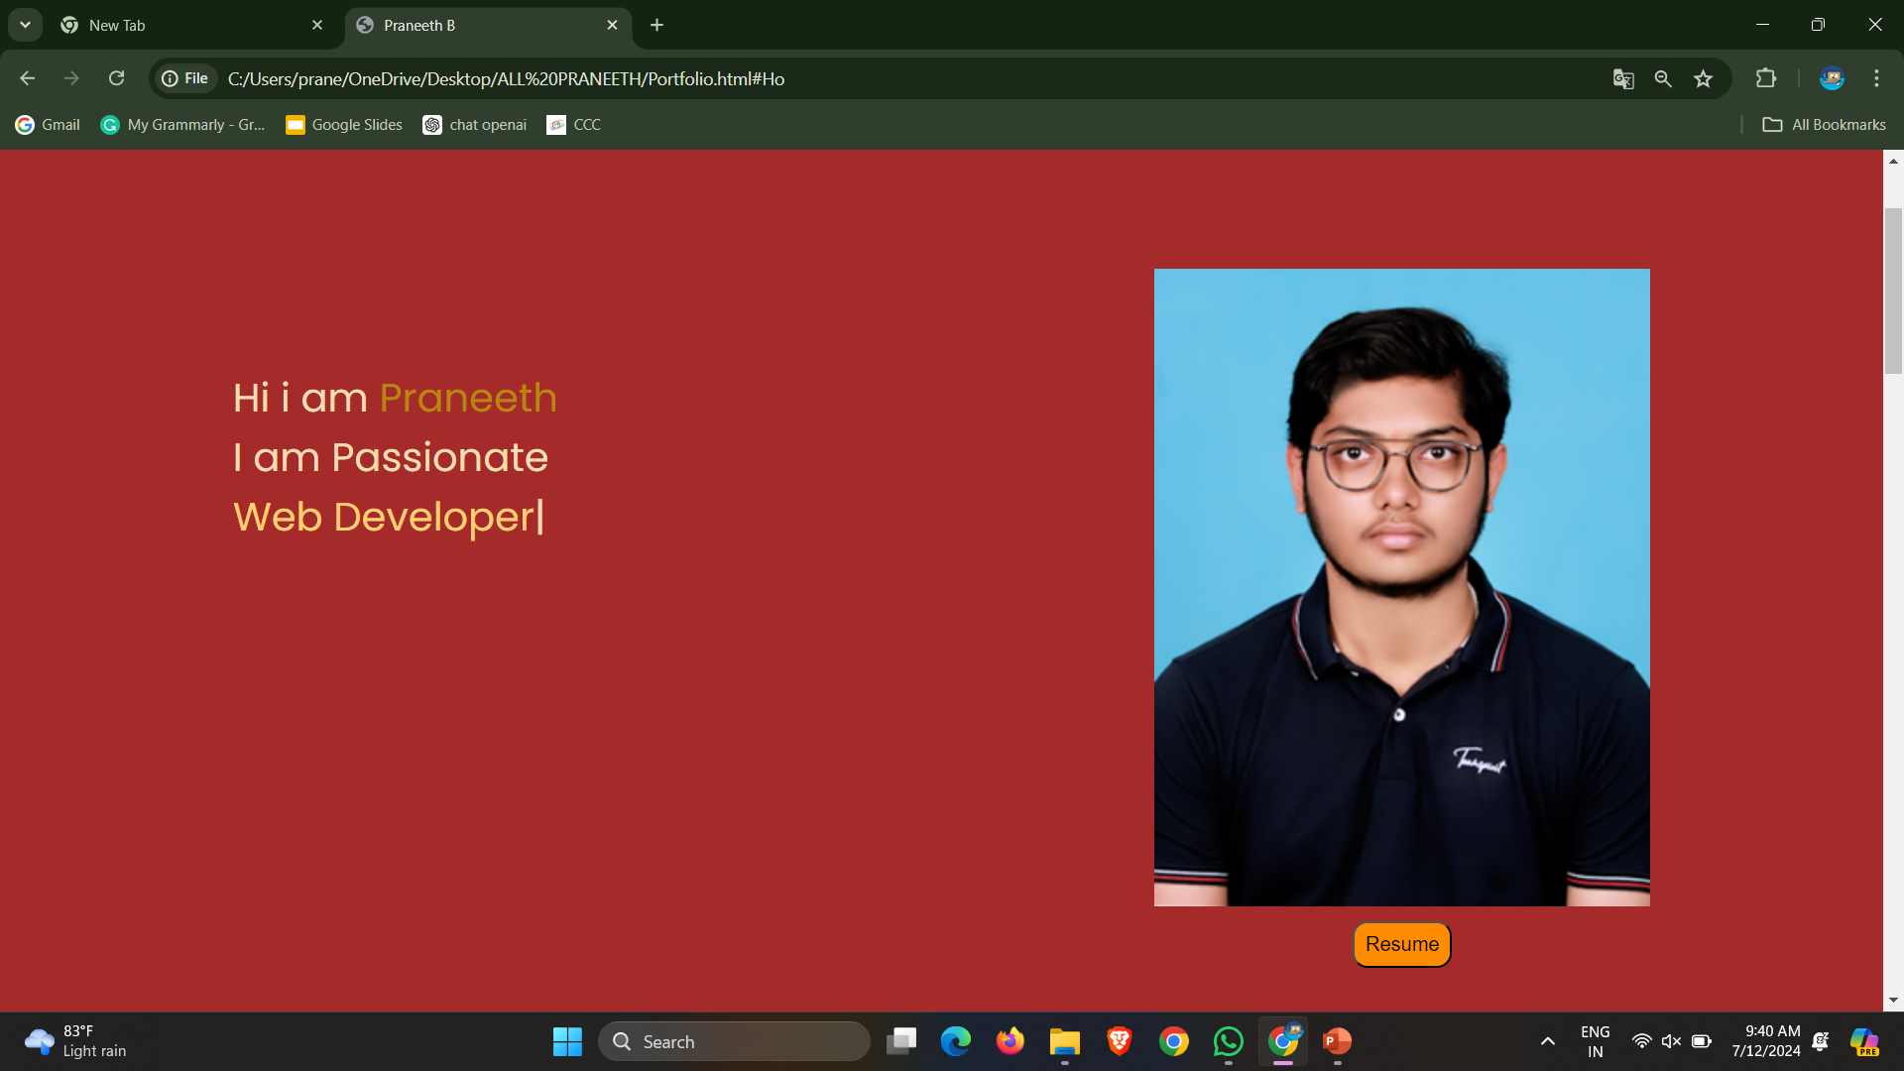
Results

Slide 14
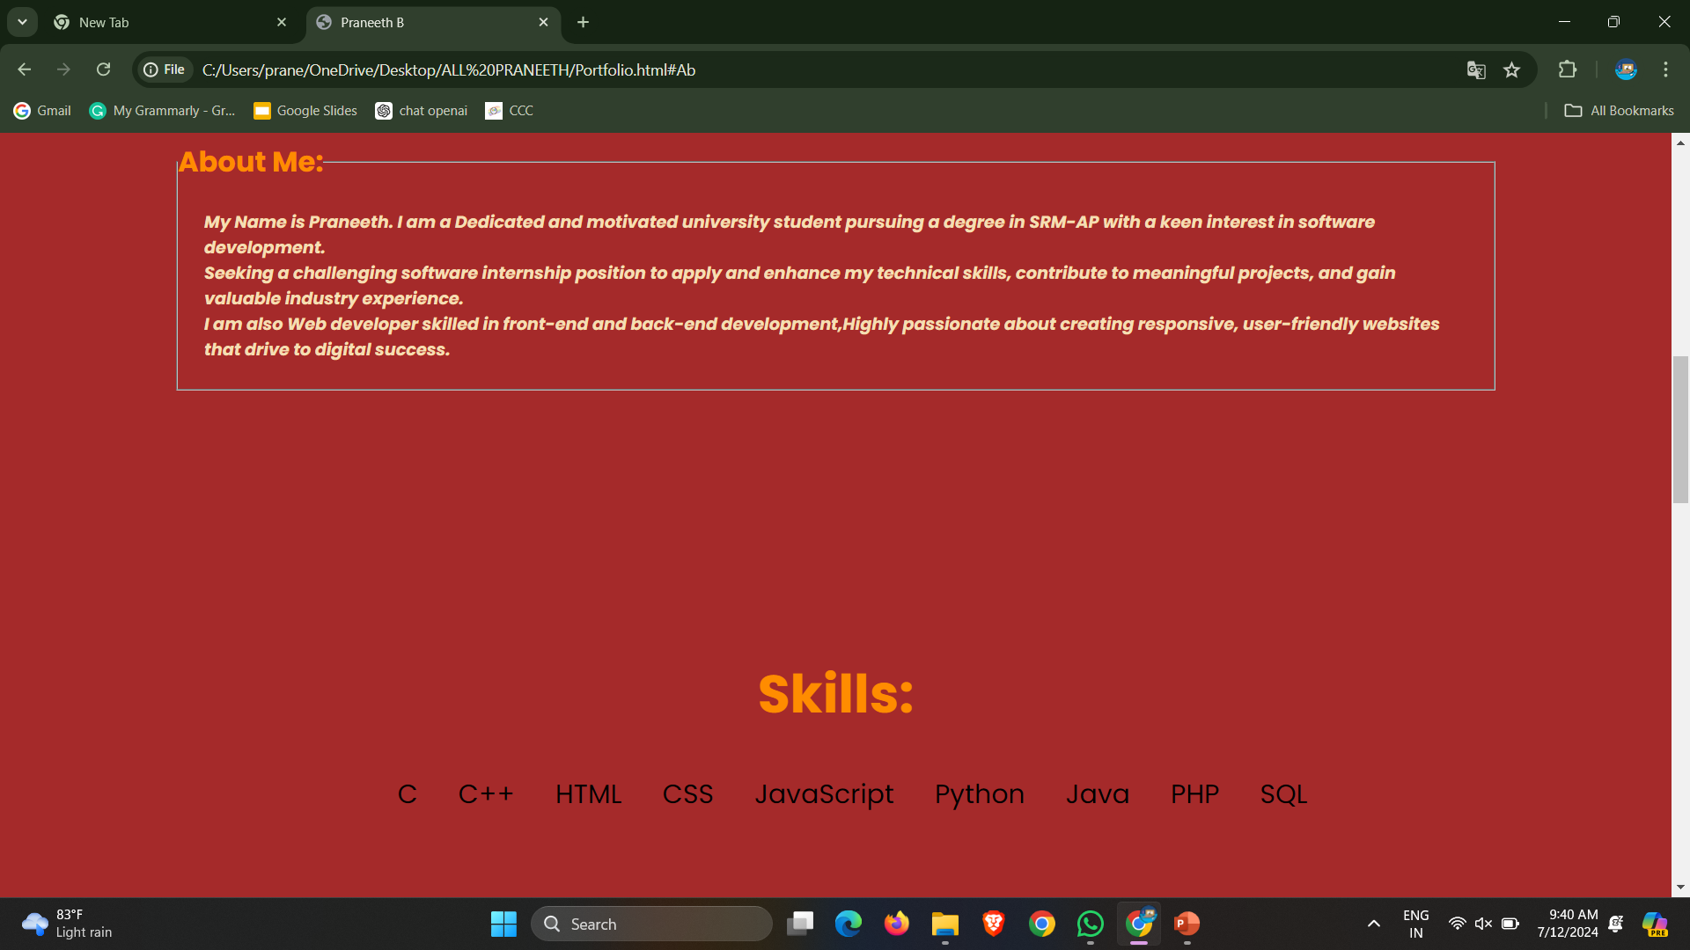
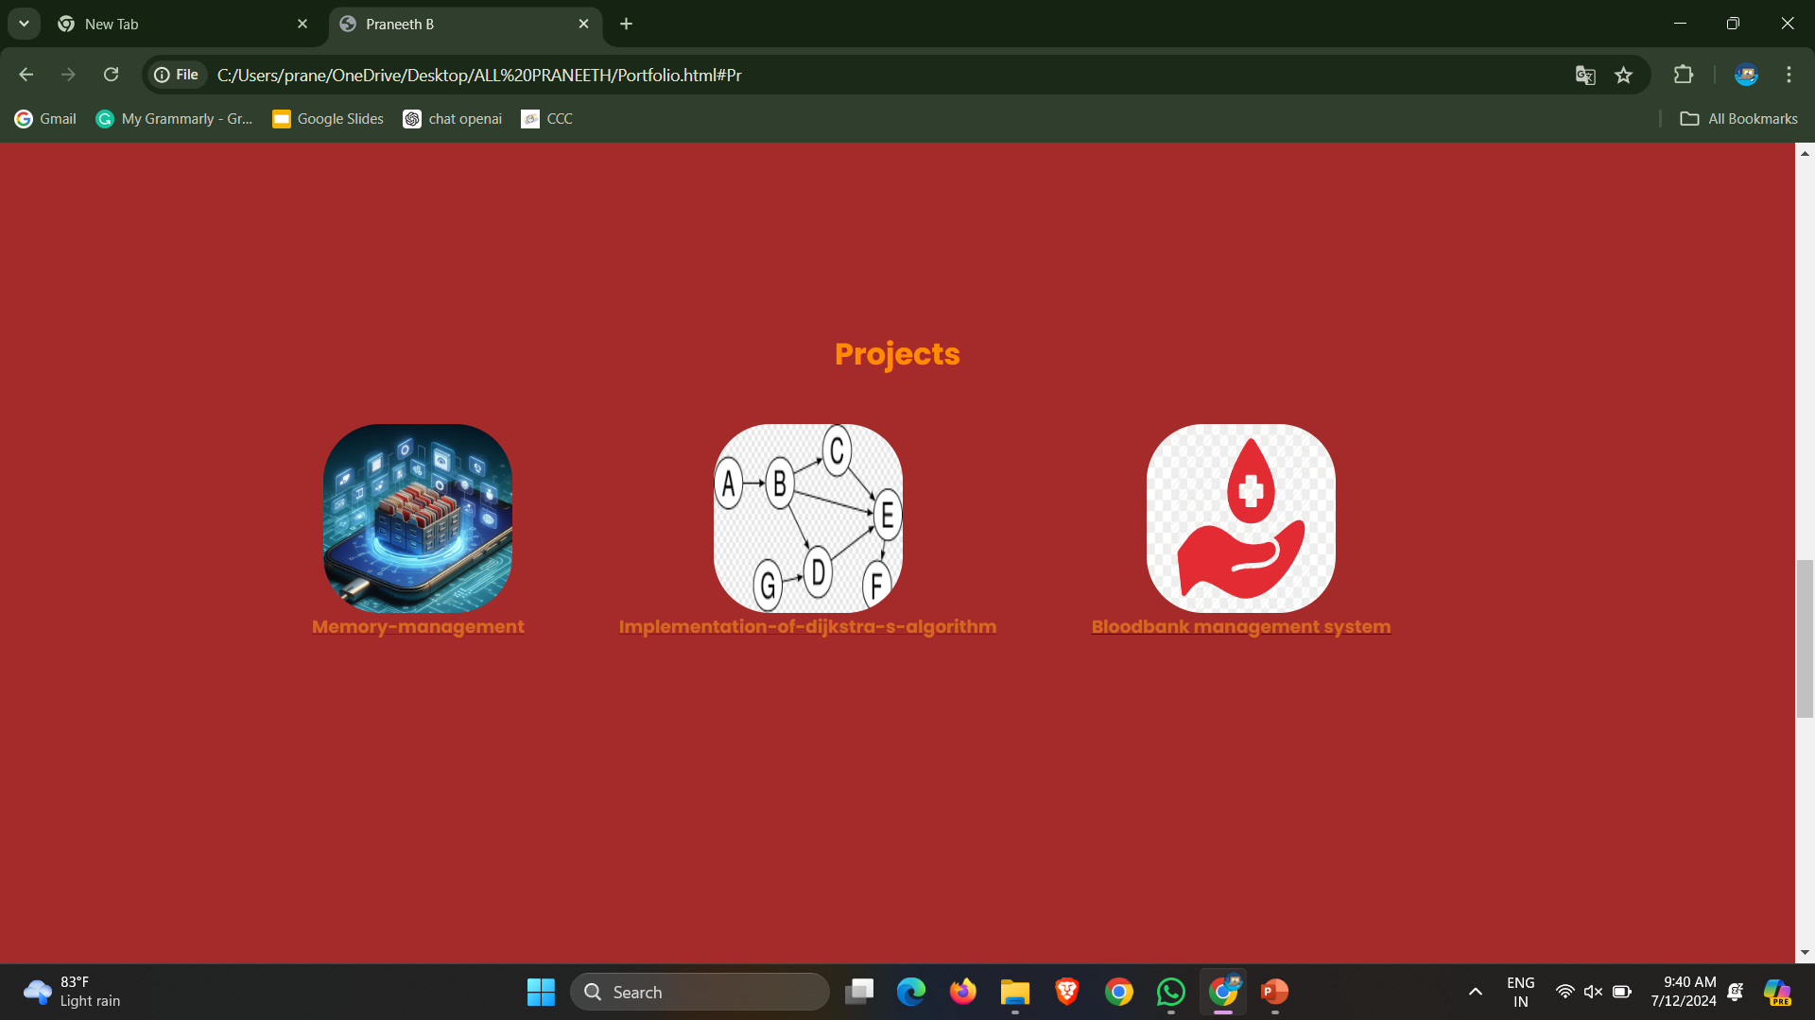
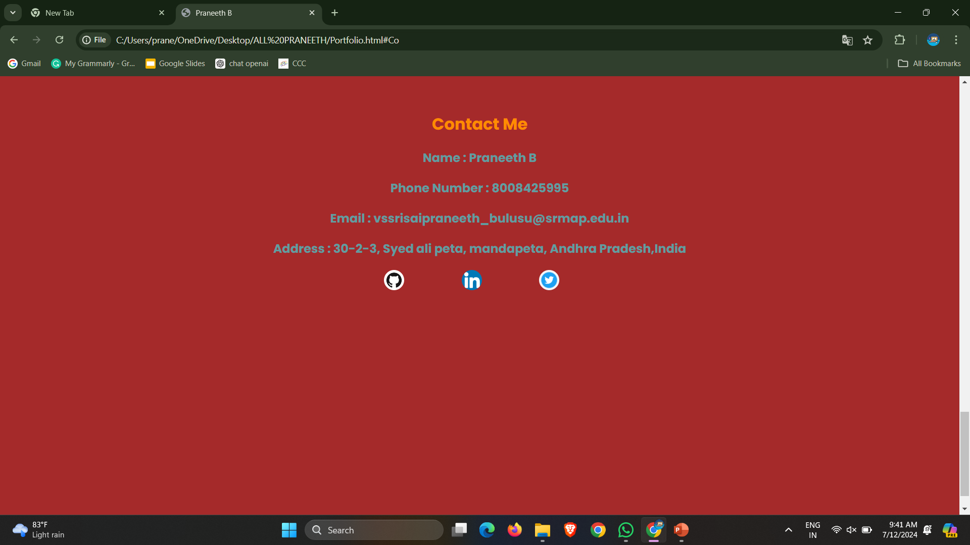

Slide 15
Links
https://www.geeksforgeeks.org/front-end-development/
https://www.w3schools.com/js/
https://create.microsoft.com/en-us
https://skills.yourlearning.ibm.com/?_ga=2.247597255.1321776411.1717390299-317707596.1717390298&lang=en&ngo-id=0107&strategy=google

Slide 16
Thank you
Presentation done by:
Bulusu V S Sri Sai Praneeth
AP22110010049
SRM University AP

